Slide 1




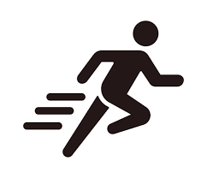
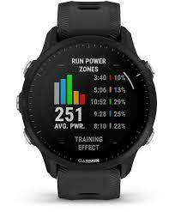


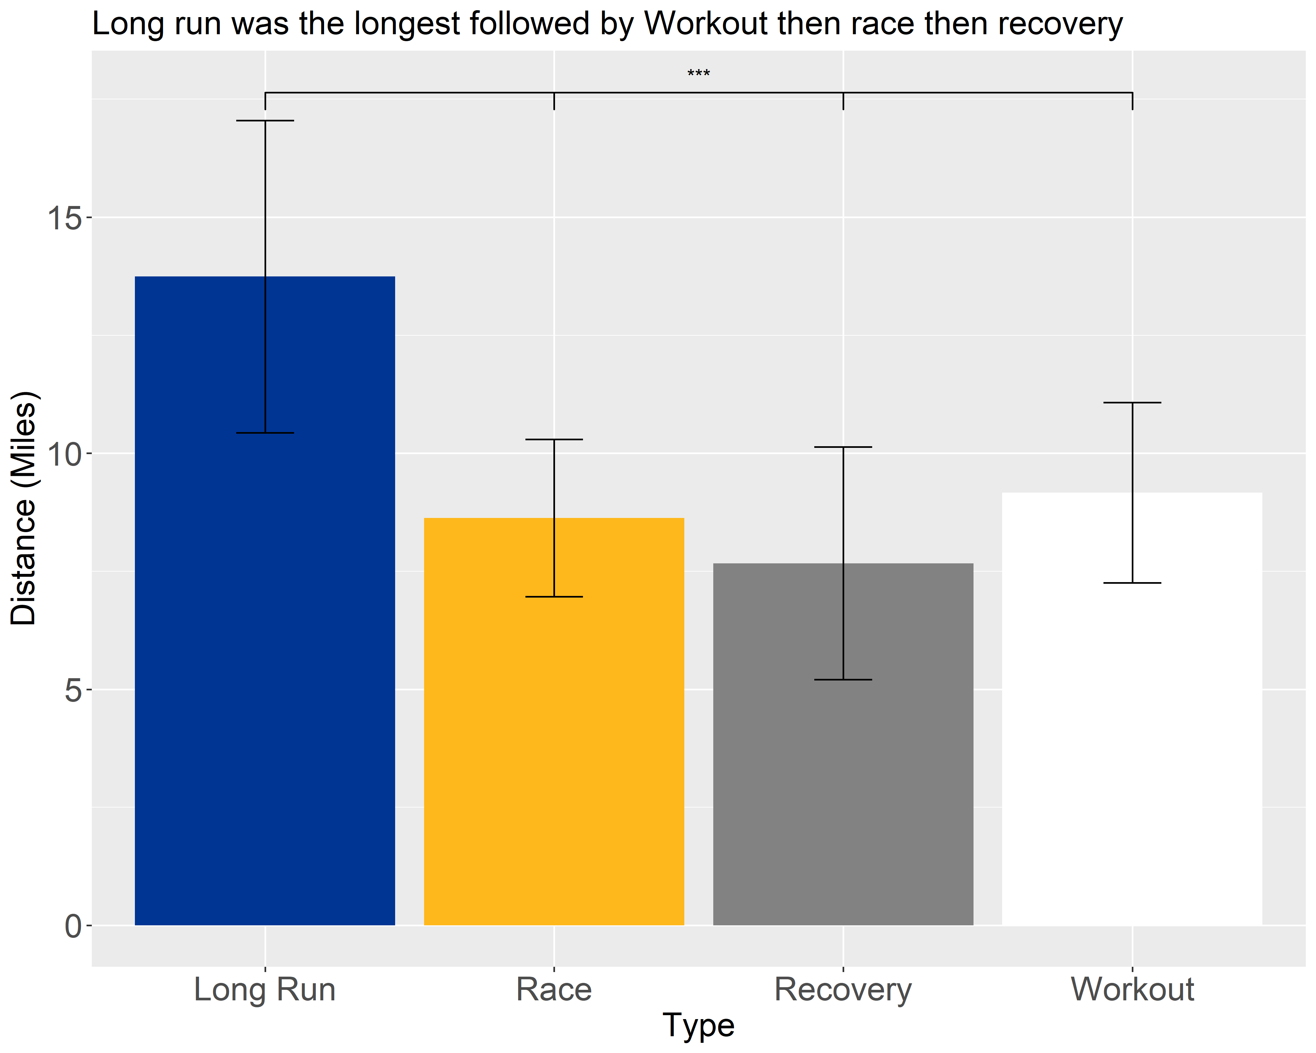
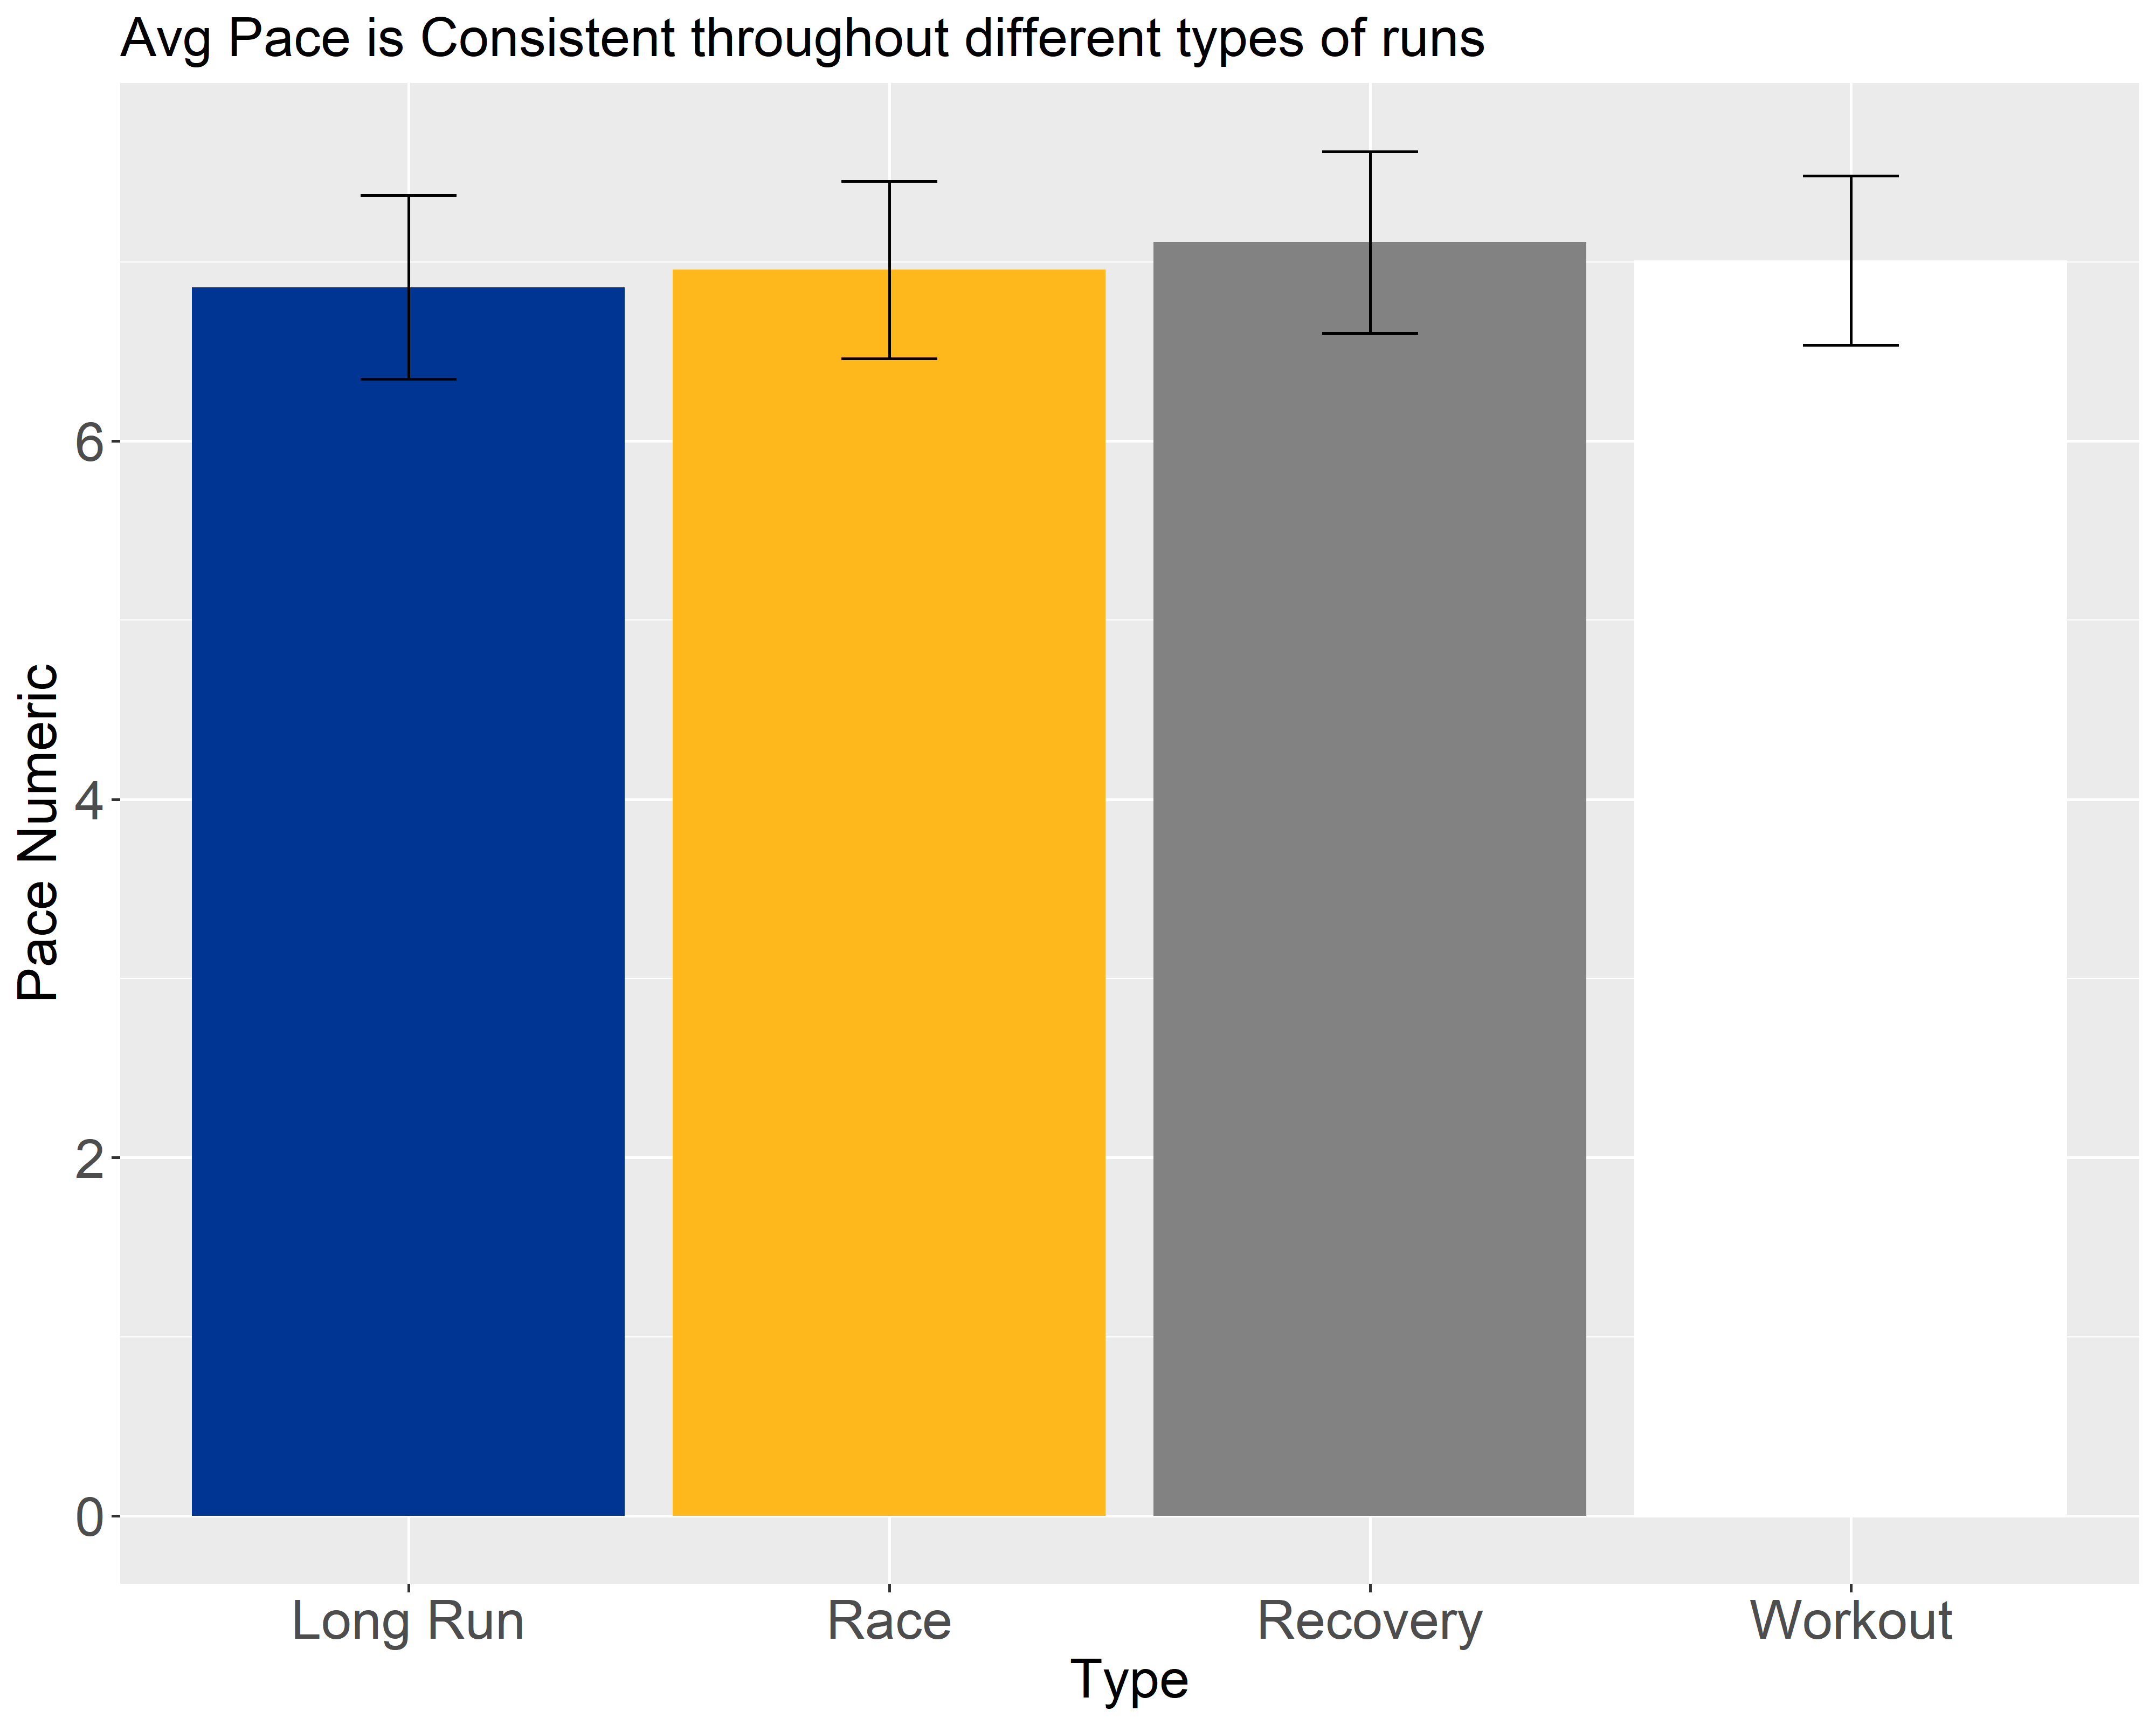
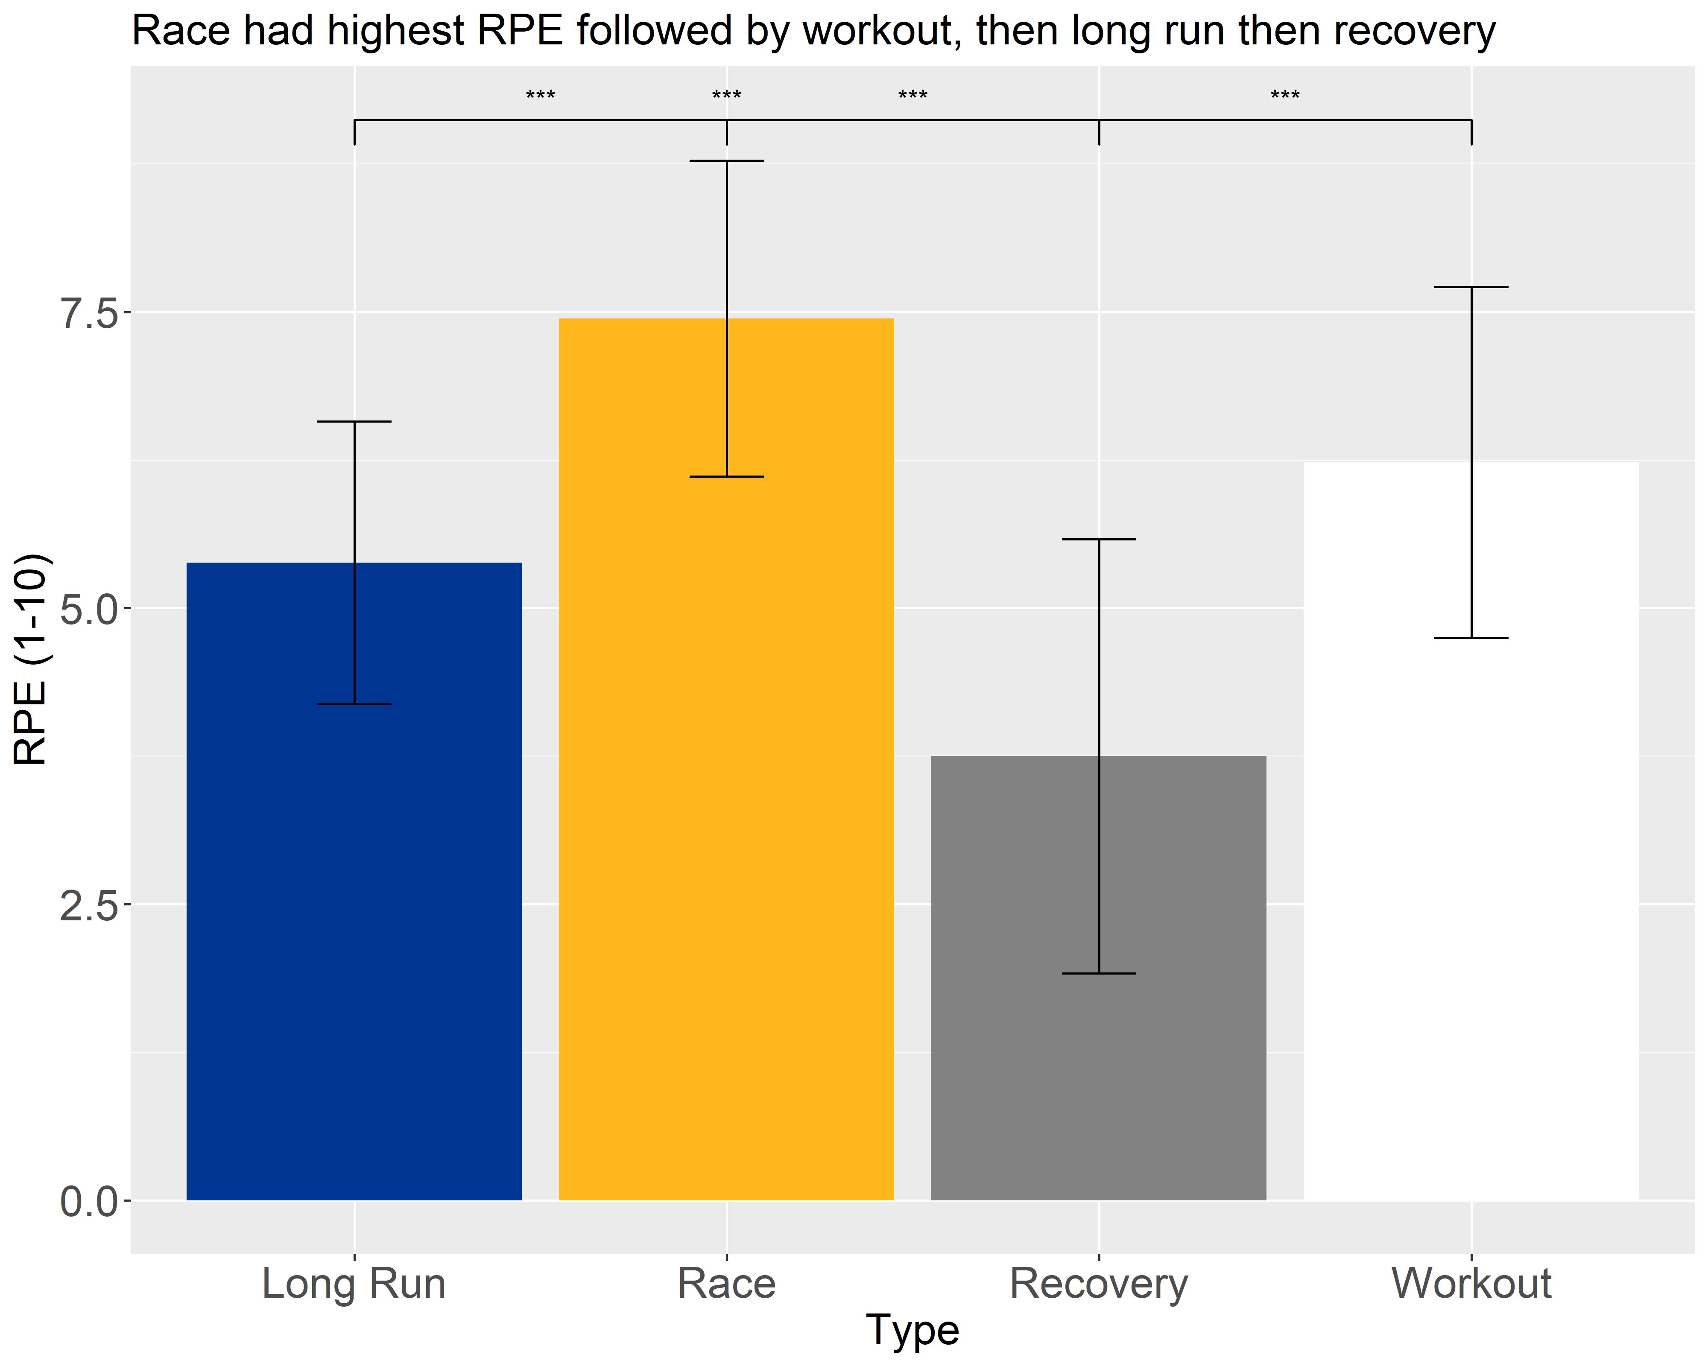
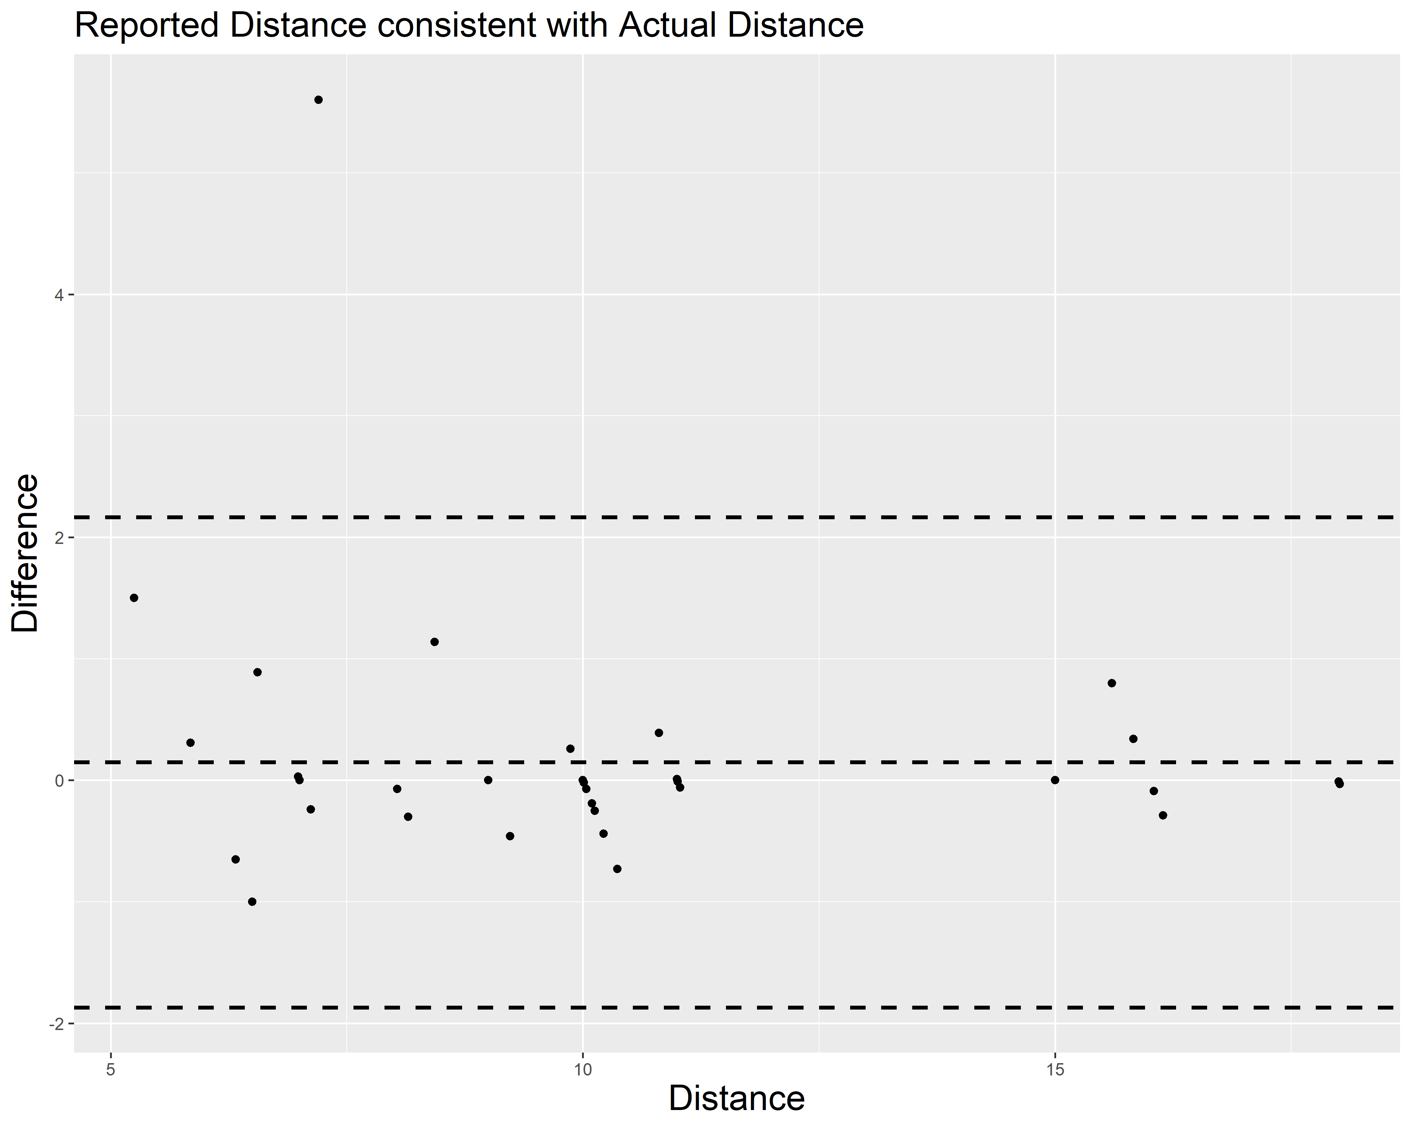
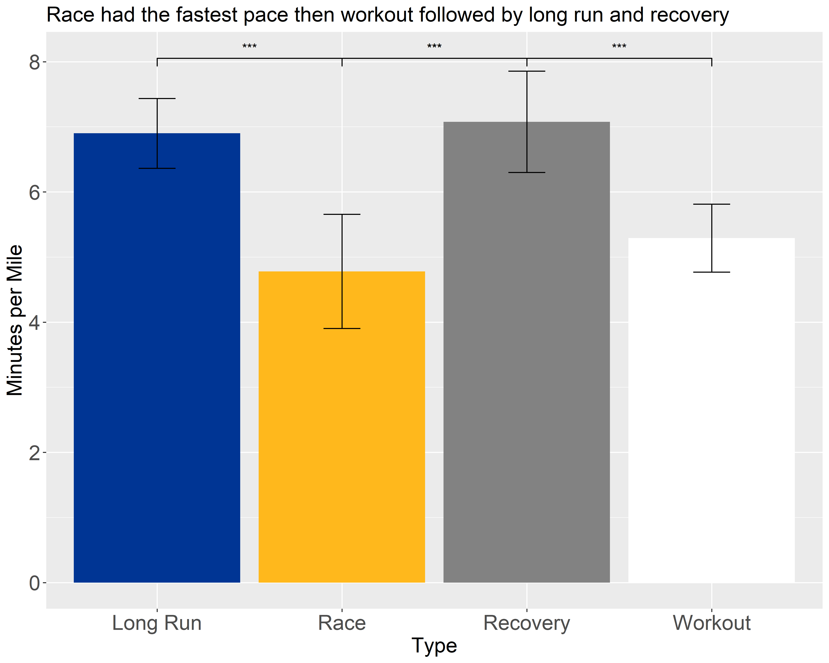
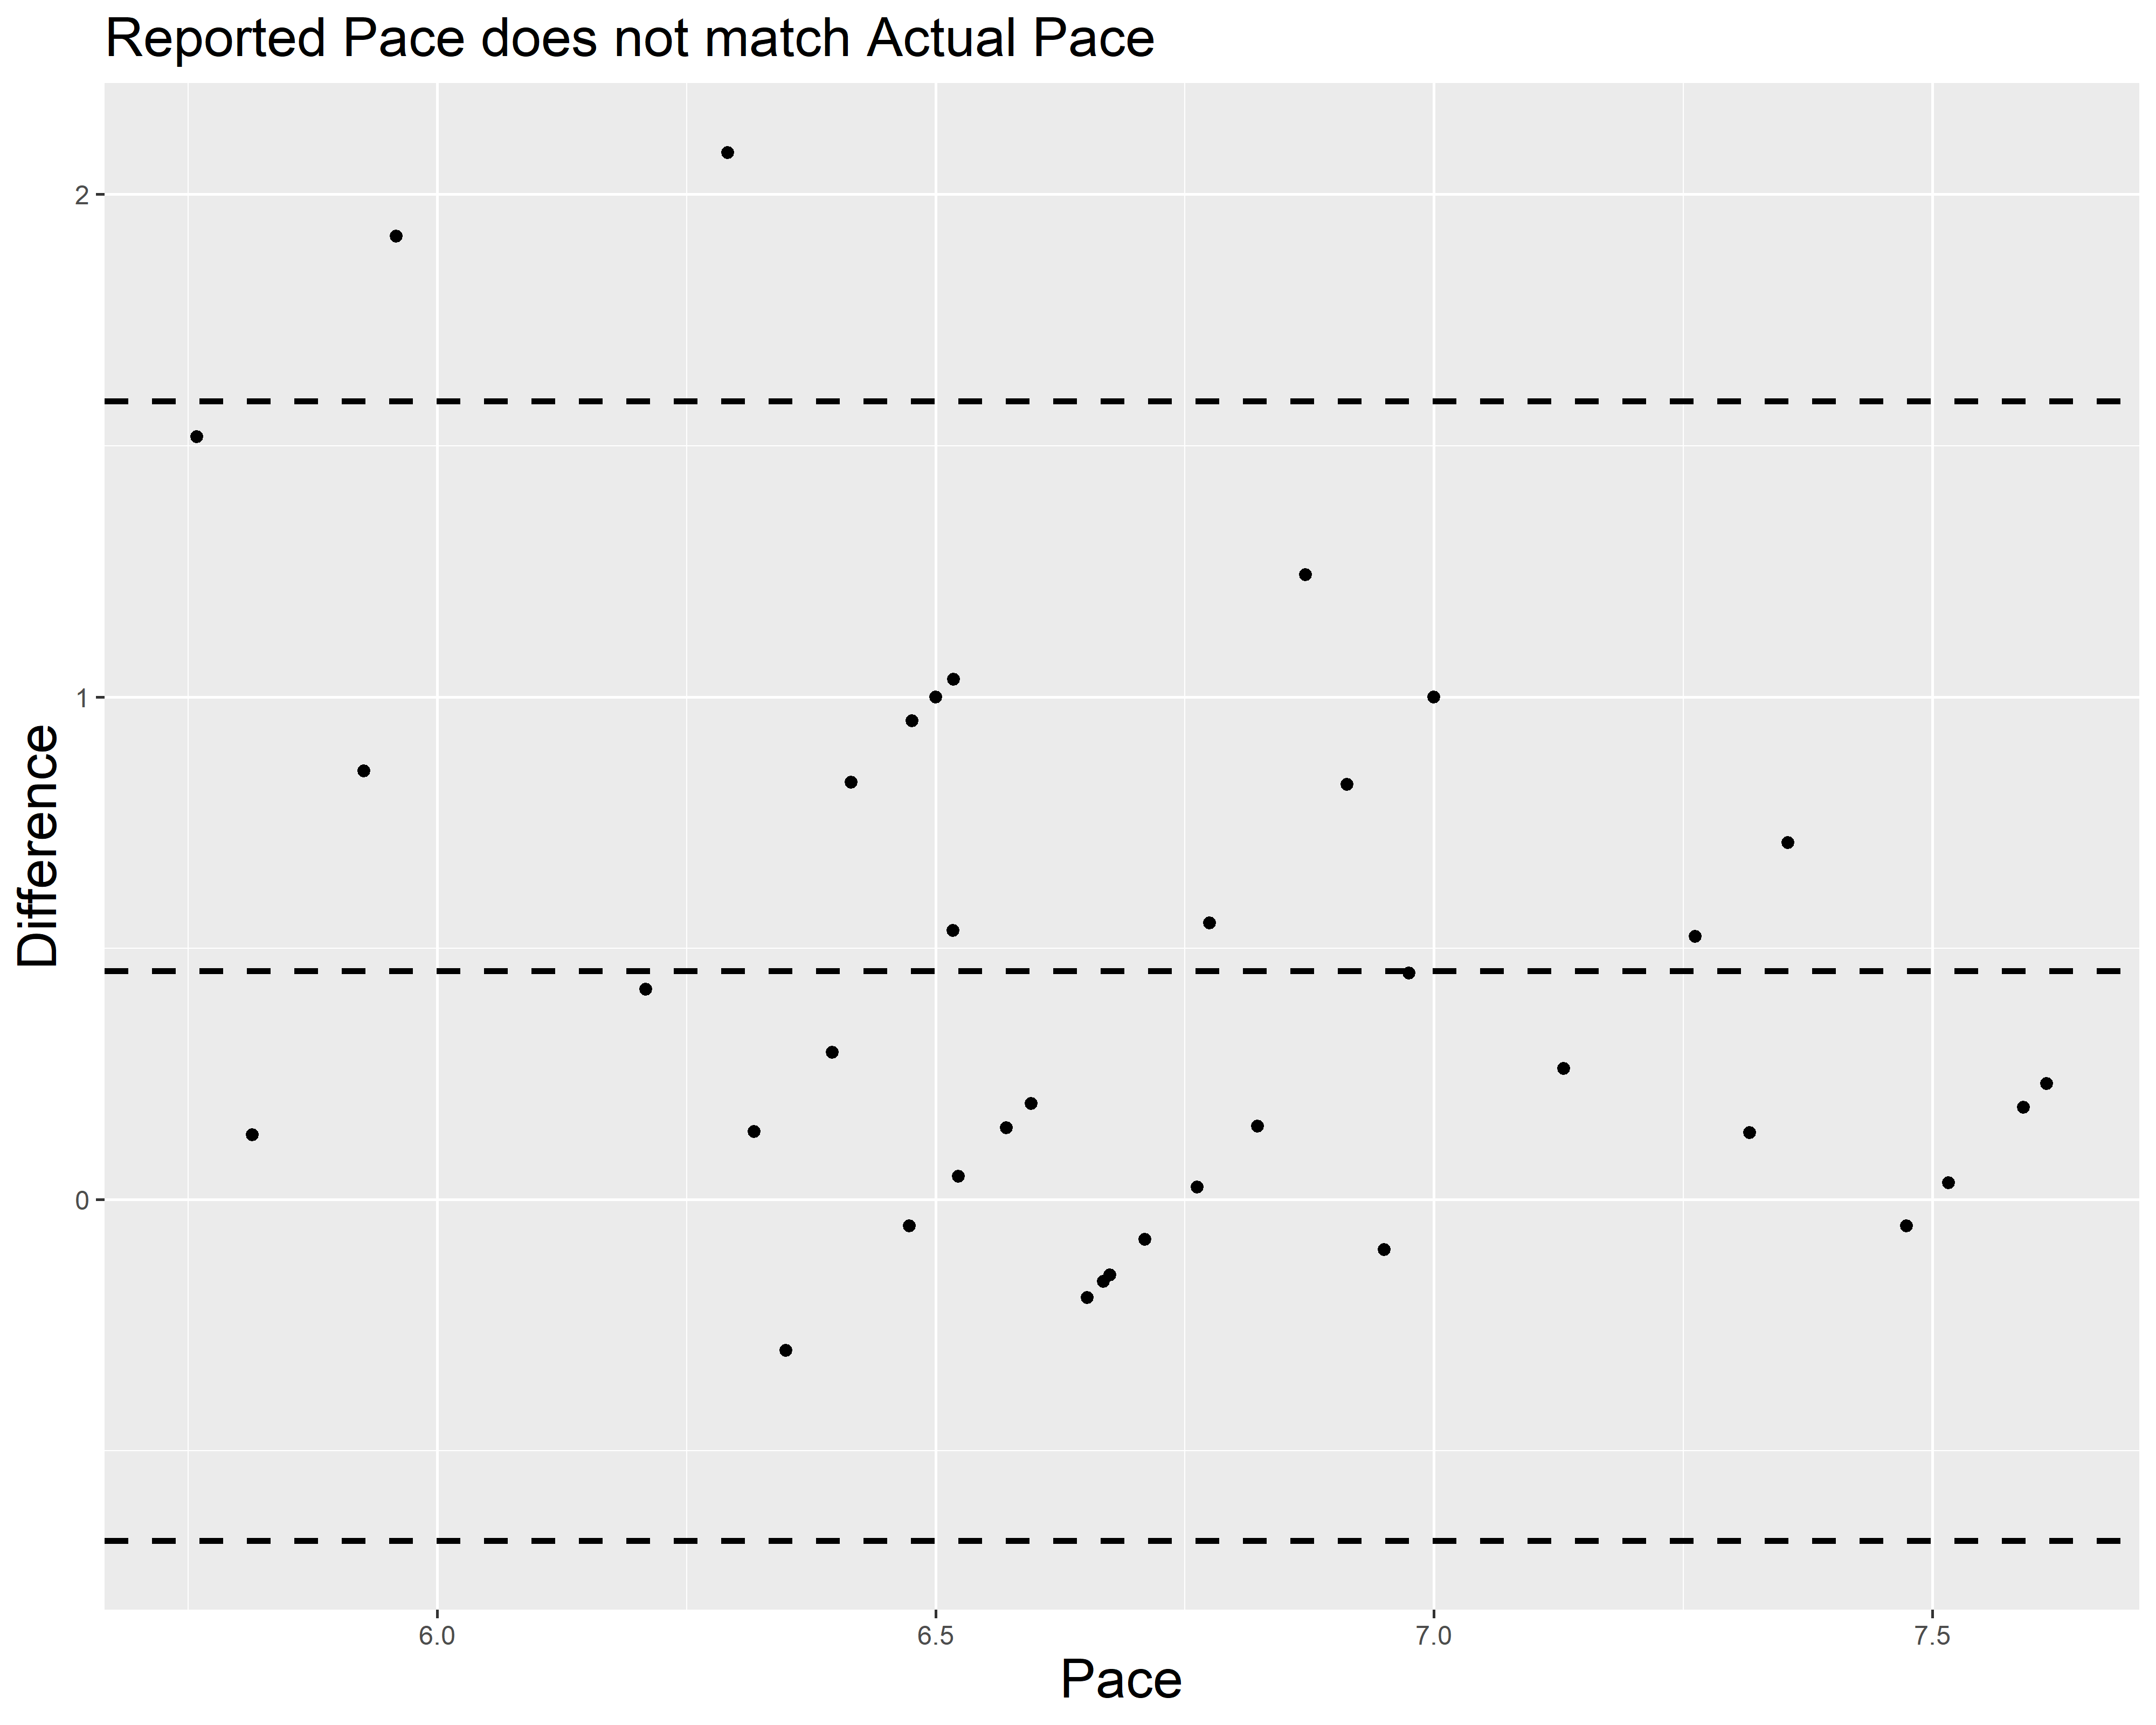
Factors Influencing Ratings of Perceived Exertion in Division I Cross Country Runners
Michael Paustian^{1,2}, Dr. Felix Proessl², Dr. Katelyn Allison¹
Department of Sports Medicine and Nutrition¹, Department of Athletics², University of Pittsburgh, Pittsburgh, PA, USA
INTRODUCTION
METHODS
Ratings of perceived exertion (RPE) is a common method utilized by sports coaches to calculate the internal load placed on athletes. Too high workloads can lead to injury or overtraining syndrome (OTS^{)2,5.}
Collegiate athletes must balance a strenuous training schedule and rigorous course work which can impact mental health, nutrition, and sleep^{6,7,8}.
Several studies have looked at various factors such as delayed onset muscle soreness (DOMS), physical fatigue, stress, sleep, mental fatigue, and distance of a run and found only mental fatigue impacted RPE^{1,3,4,10}.
No studies have investigated how these factors impact division I cross country runners.
Purpose: Determine what factors influence RPE in division I cross country runners and to assess the validity of utilizing wellness questionnaires to track mileage and pace
Long Run
Step 1: Complete Pre Run Questionnaire
Step 2: Run
Step 3: Upload Run to Strava or Garmin
Step 5: Wellness Questionnaire
N= 18 DI XC Runners 7 Women 11 Men
7 First Years 6 Sophomore 4 Juniors 1 Senior
Race
How far did they run? At what pace?
Number of meals and drinks?
How fatigued and sore are you?
How much stress did you experience?
RPE of Run?
Recovery
Workout
Soreness and Fatigue (0-10)
Data Analysis
Pair Wise T Test
ANOVA
Experimental protocol. Thirty three healthy athletes were recruited to participate in this study. During a week of competition, athletes completed four different types of runs: a long run, a workout, a recovery run, and a race. Prior to their run, athletes filled out a survey indicating on a scale 0-10, their soreness and fatigue Afterwards their run, athletes filled out a wellness questionnaire that asked how long their run was in miles, at what pace they completed their run in minutes per mile, how many meals they consumed, how many drinks they consumed, and on a scale 0-10; how sore were they, how fatigued were they, how much good stress and bad stress they experienced throughout the day, and the RPE of their run. Finally, data from 18 athletes was collected was collected from their Strava and Garmin Profiles to compare the miles and average pace they ran to what they reported on the wellness questionnaire. All data was exported to Rstudio for data analysis. Intraclass correlation and Bland Altman plots were performed to look at the accuracy of the reported mileage. ANOVA tests were performed to compare the average distance, average fastest pace, and average RPE of each type of run. A repeated ANOVA was completed to look at how fatigue and soreness changed throughout the week of training. Finally, pairwise t test with a Bonferroni correction was completed to look at how miles, pace, and RPE differed by the different types of runs.
RESULTS
DISCUSSION
This study demonstrated that RPE varied across the different types of workouts and that pace affected the RPE of the run where as sleep, soreness, stress, fatigue, and distance of the run did not impact RPE.
Athletes accurately report distance they ran but do not accurately report their average pace. Coaches may want to ask for fastest pace rather than average
When coaches are planning their workouts for division I cross country runners, coaches should communicate with their athletes that pace impacts the difficulty of their run the most rather than the distance.
References
1. Brownsberger, J., Edwards, A., Crowther, R., & Cottrell, D. (2013). Impact of mental fatigue on self-paced exercise. International Journal of Sports Medicine, 34(12), 1029-1036.
2. Dishman, R., Patton, R., Smith, J., Weinberg, R., & Jackson, A. (1987). Using perceived exertion to prescribe and monitor exercise training heart rate. International Journal of Sports Medicine, 8(03), 208-213.
3. Faulkner, J., Parfitt, G., & Eston, R. (2008). The rating of perceived exertion during competitive running scales with time. Psychophysiology, 45(6), 977-985.
4. Haddad, M., Chaouachi, A., Wong, D. P., Castagna, C., Hambli, M., Hue, O., & Chamari, K. (2013). Influence of fatigue, stress, muscle soreness and sleep on perceived exertion during submaximal effort. Physiology & behavior, 119, 185-189.
5. Kreher, J. B., & Schwartz, J. B. (2012). Overtraining Syndrome:A Practical Guide. Sports Health, 4(2), 128-138. https://doi.org/10.1177/1941738111434406
6. Mah, C. D., Kezirian, E. J., Marcello, B. M., & Dement, W. C. (2018). Poor sleep quality and insufficient sleep of a collegiate student-athlete population. Sleep health, 4(3), 251-257.
7. Shephard, R., & Shek, P. (1994). Potential impact of physical activity and sport on the immune system--a brief review. British journal of sports medicine, 28(4), 247-255.
8. Souissi, W., Hammouda, O., Ayachi, M., Ammar, A., Khcharem, A., de Marco, G., Souissi, M., & Driss, T. (2020). Partial sleep deprivation affects endurance performance and psychophysiological responses during 12-minute self-paced running exercise. Physiology & behavior, 227, 113165.
9. Sundgot-Borgen, J., & Torstveit, M. K. (2004). Prevalence of eating disorders in elite athletes is higher than in the general population. Clinical journal of sport medicine, 14(1), 25-32.
10. Van Cutsem, J., Marcora, S., De Pauw, K., Bailey, S., Meeusen, R., & Roelands, B. (2017). The effects of mental fatigue on physical performance: a systematic review. Sports medicine, 47(8), 1569-1588.
Top figure shows that distance varied across the various types of runs while the bottom examines how accurate the athletes reported the distance they ran.
Average pace was consistent throughout all types of runs, therefore we thought it would be better to look at fastest pace rather than average
Top figure shows how RPE varied across the four types of runs with the race having the highest RPE followed by workout then long run. Bottom figure examined the accuracy of reported pace versus actual. Overall athletes were not accurate when reporting their pace with most being half a minute to a minute off
ACKNOWLEDGEMENTS
I would like to thank Dr. Felix Proessl, Dr. Katelyn Allison, and the student athletes who participated in this study. Without their help and participation, this study would not have been possible.

